Slide 1
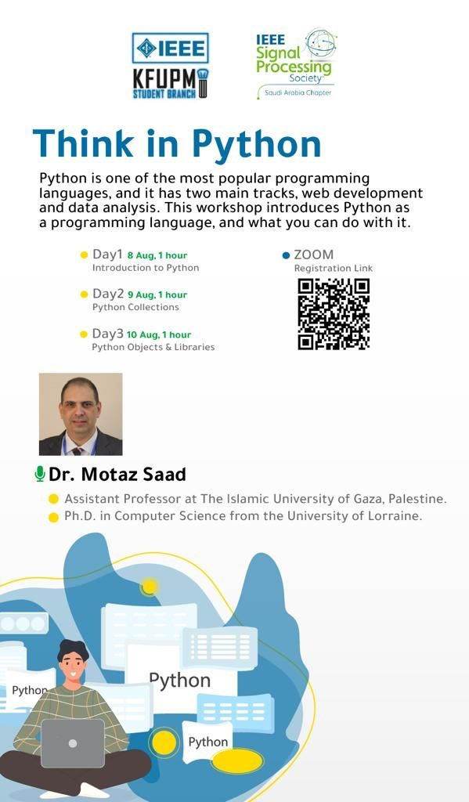
Think in Python
A workshop organized by IEEE signal processing society in cooperation with IEEE KFUPM Student Branch.
8-10 August 2021
Motaz Saad

Slide 2
Day1: Introduction to Python
Introduction
Why python
Tracks
Programming Environment
Speak Python

Slide 3

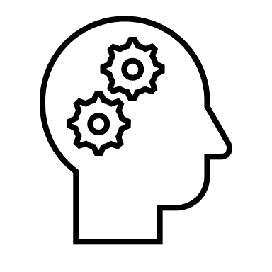

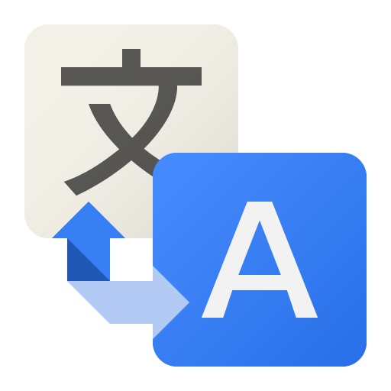
A Philosophical definition
A programming language is a thinking tool that you can use to realize your ideas
Python is a language (like English, French, Spanish, …) that you use it to speak to machines and tell them what to do
To be fluent in Python, you should practice and speak python everyday ☺

Slide 4
A Technical definition
Easy
High level
Open source
Portable
Interpreted
Object oriented
Extensible
Large standard libraries

Slide 5
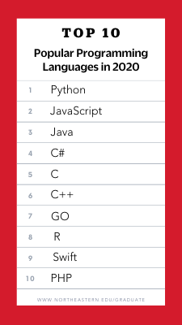
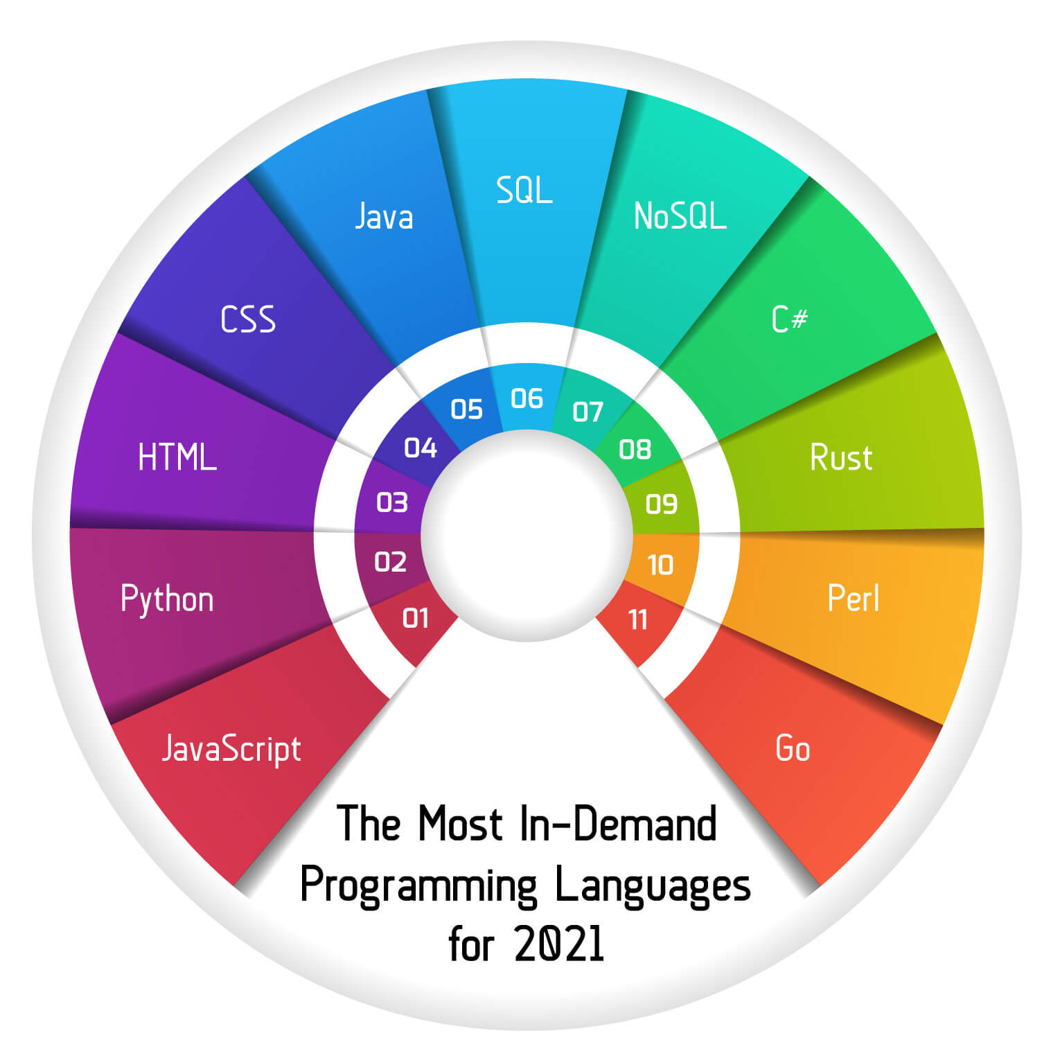
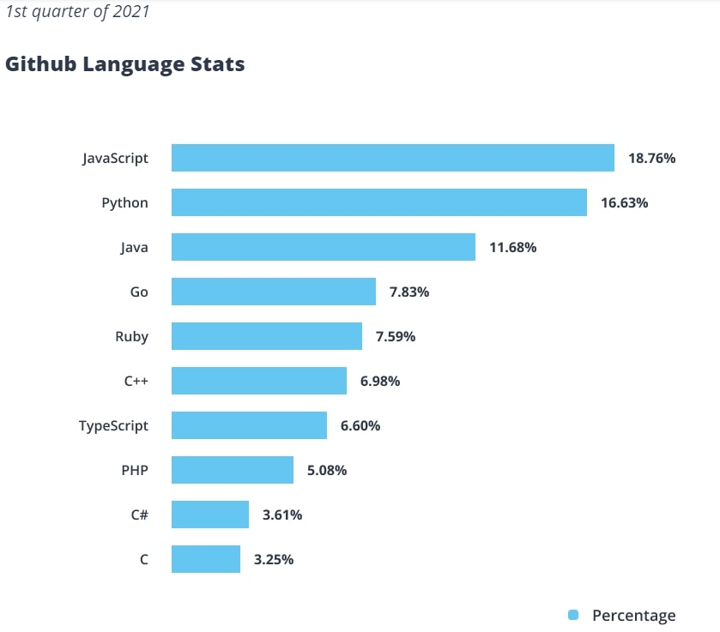
Popular programming languages 2020 / 2021

Slide 6
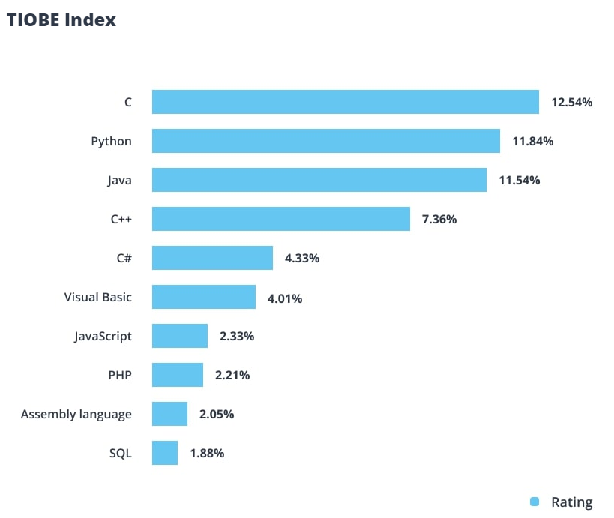
TIOBE Index
The TIOBE coding community index is a measure of popularity of programming languages, made and maintained by the TIOBE Software BV based in the Netherlands. TIOBE tracks the sheer quantity of 25 search engine hits, including Google, Wikipedia, YouTube, and other sources.

Slide 7
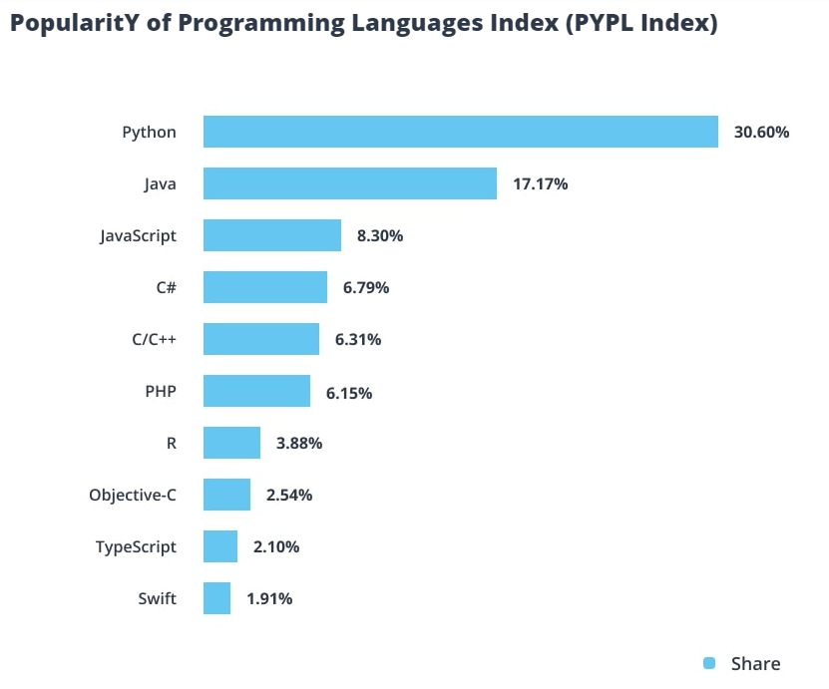
PYPL Index
PYPL, PopularitY of Programming Language, takes a narrower approach, measuring the frequency of searches for tutorials in a given language using Google Trends.

Slide 8
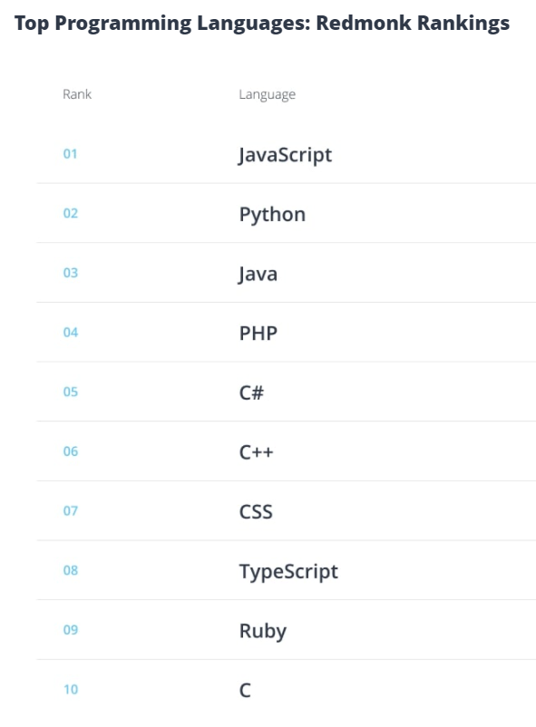
Redmonk Index
Redmonk is a developer-focused analyst firm. Redmonk experts collect information on forums for programmers and rank languages ​​by how frequently they are mentioned.

Slide 9
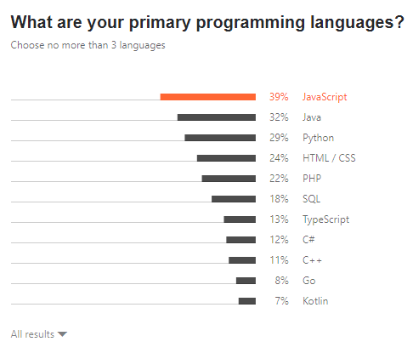
JetBrain Survey 2021

Slide 10
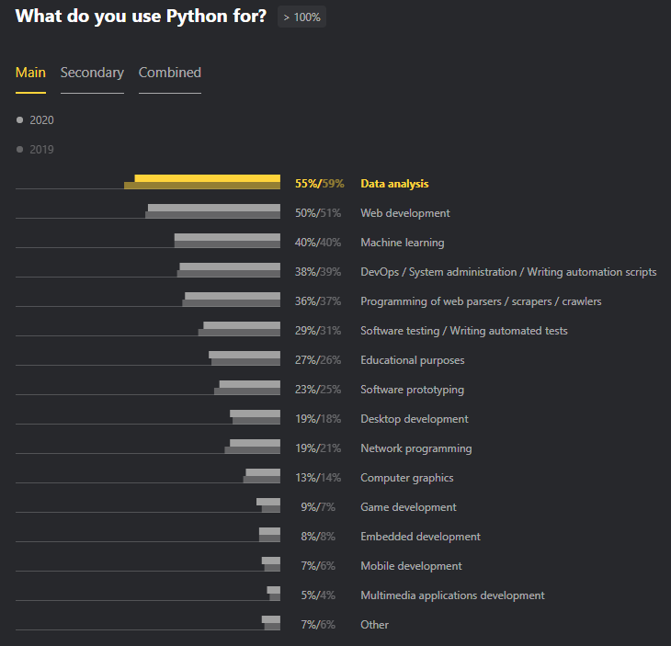
Python Developers Survey 2020 Results

Slide 11
Python Tracks
Python
Data Science
Web Development

Slide 12


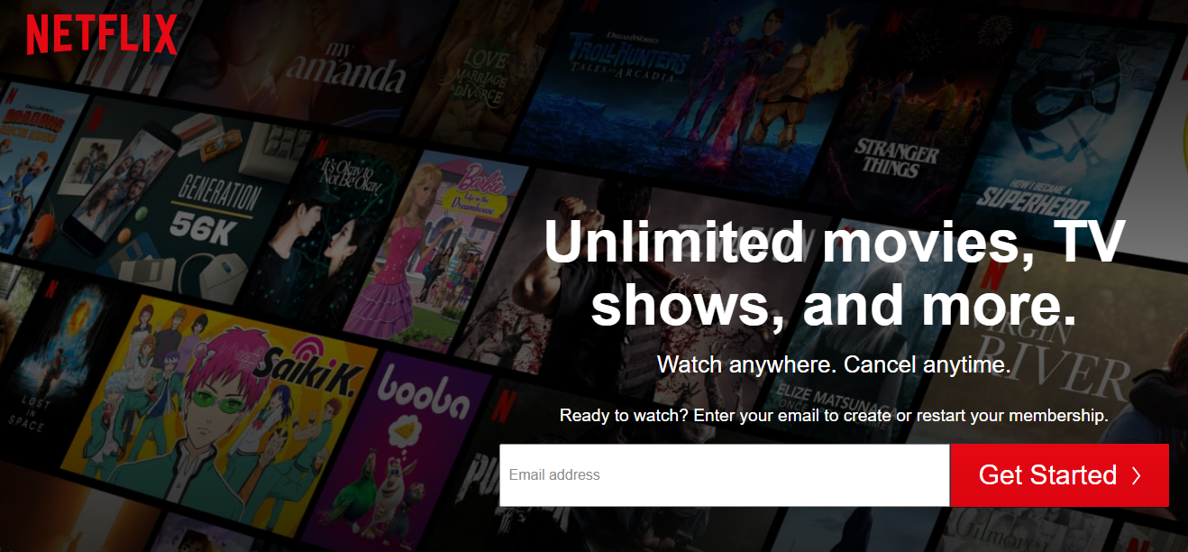
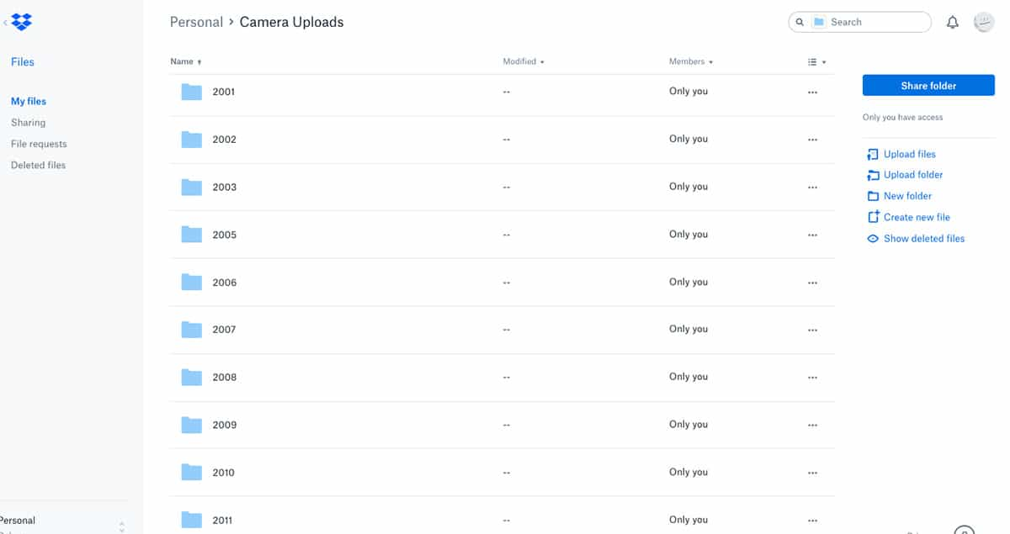

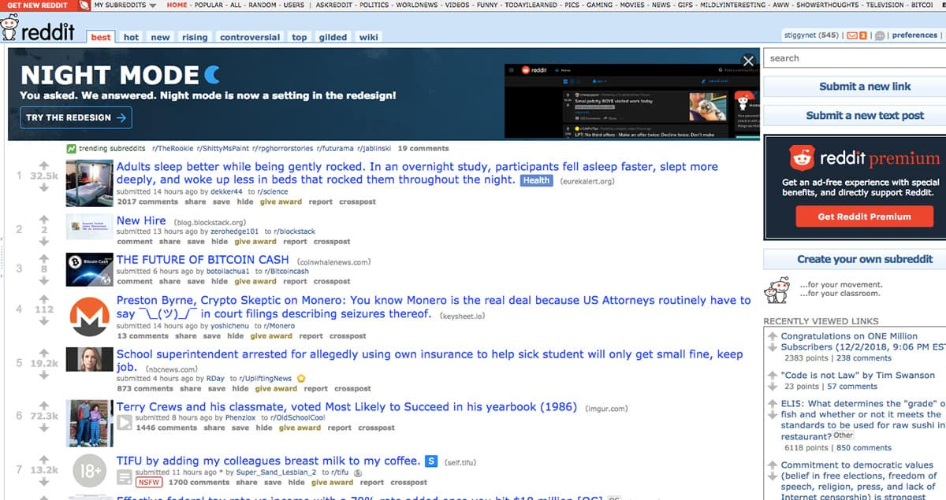
Famous Websites Built Using Python

Slide 13


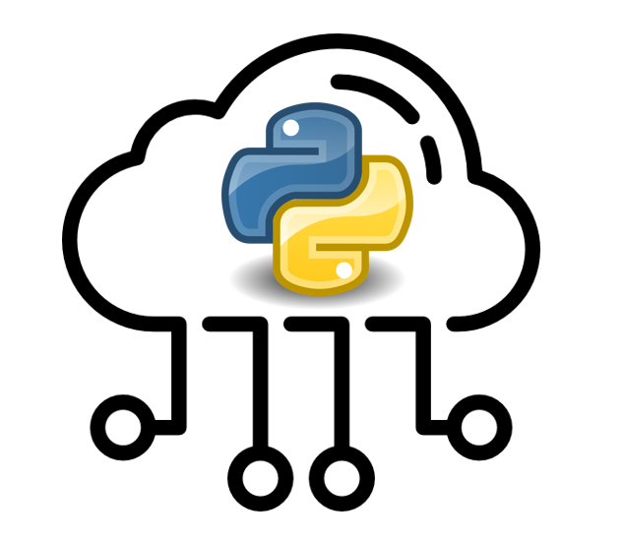
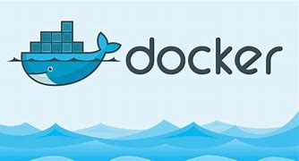
Python Programming Environment
So many options
Install pure python from python.org
Install pre-packaged platforms like Anaconda and Winpython
Python Cloud Platforms
Docker Containers

Slide 14
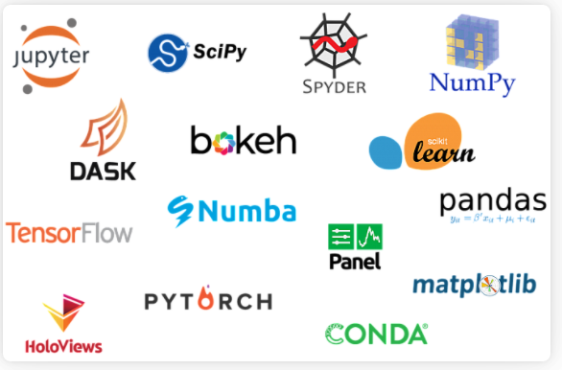
Anaconda
Support Windows, Mac, Linux
So many packages are preinstalled

Slide 15
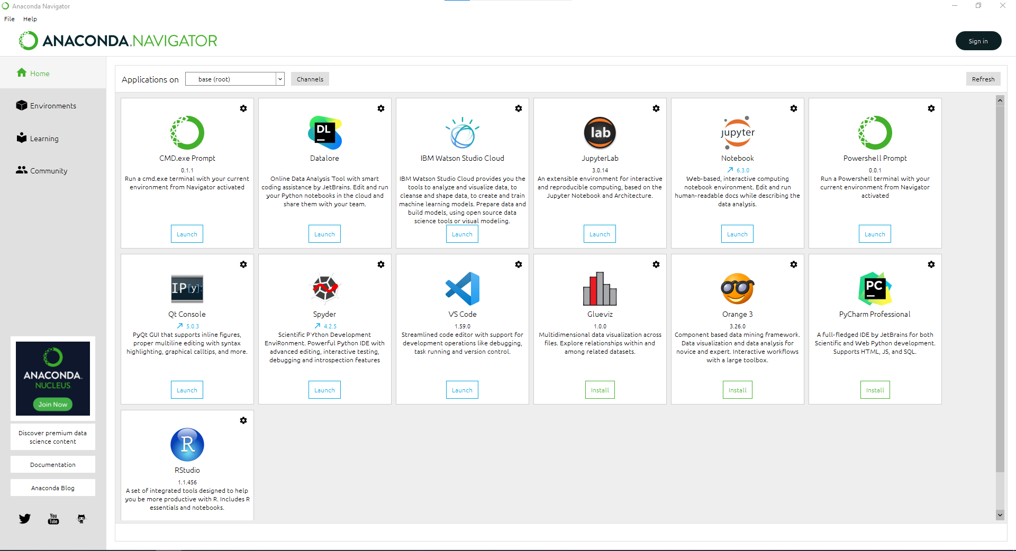

Slide 16
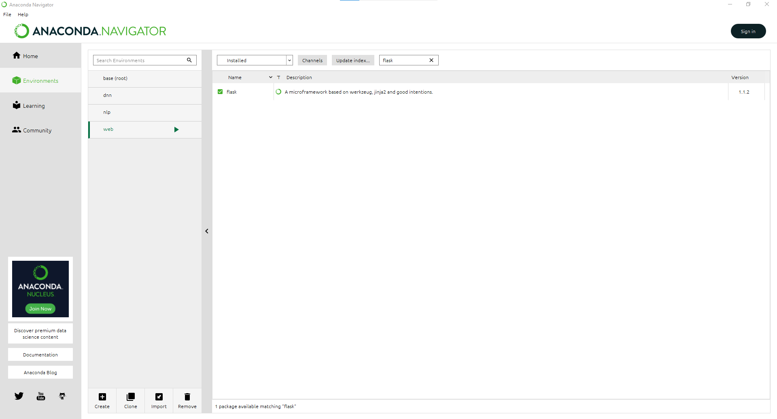

Slide 17
Python Environments
IDE
Shell
Jupyter Notebook

Slide 18
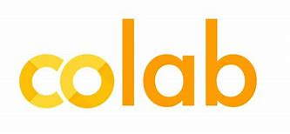




Python on the cloud
Google Colab
Kaggle
Repl.it
Microsoft Azure
Binder (mybinder.org)

Slide 19
Day1: Writing Python code
Variables & Naming Convention
Conditional statements
Error and exception handling
Functions and naming convention again
Best practices for writing functions

Slide 20
Indentation to define blocks
x = 5
if x > 2 :
print('Bigger than 2')
print('Still bigger')
print('Done with 2')
for i in range(5) :
print(i)
if i > 2 :
print('Bigger than 2')
print('Done with i', i)
print('All Done')

Slide 21
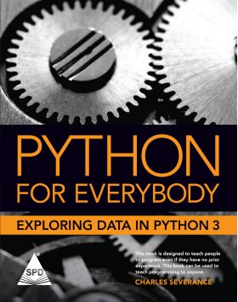
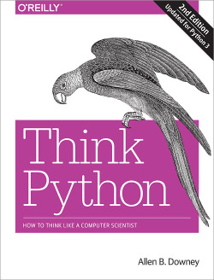
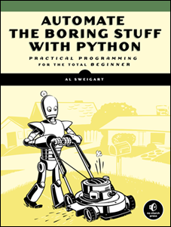
Books
More books: Open-Source Python Programming Books Licensed Under Creative Commons – معتز خالد سعد | Motaz Saad (wordpress.com)

Slide 22

QA

Slide 23
Day2: Writing Python code
Loops and iterations (iteration variable, while, for loops)

Slide 24
QA

Slide 25
Day3:
Share your Hacker Rank Profile
Python Strings
Collections: Lists, Tuples, Dictionaries, set
Files
Python Objects
Python Libraries

Slide 26
QA

Slide 27
Libraries / Resources / Courses
Raspberry Pi دورة راسبيري باي https://youtube.com/playlist?list=PLM... @Muhammed Essa
7+ Python Engineering Modules for Electronics Engineers - Bald Engineer
electricpy · PyPI

Slide 28

This Photo by Unknown Author is licensed under CC BY-SA

